Slide 1
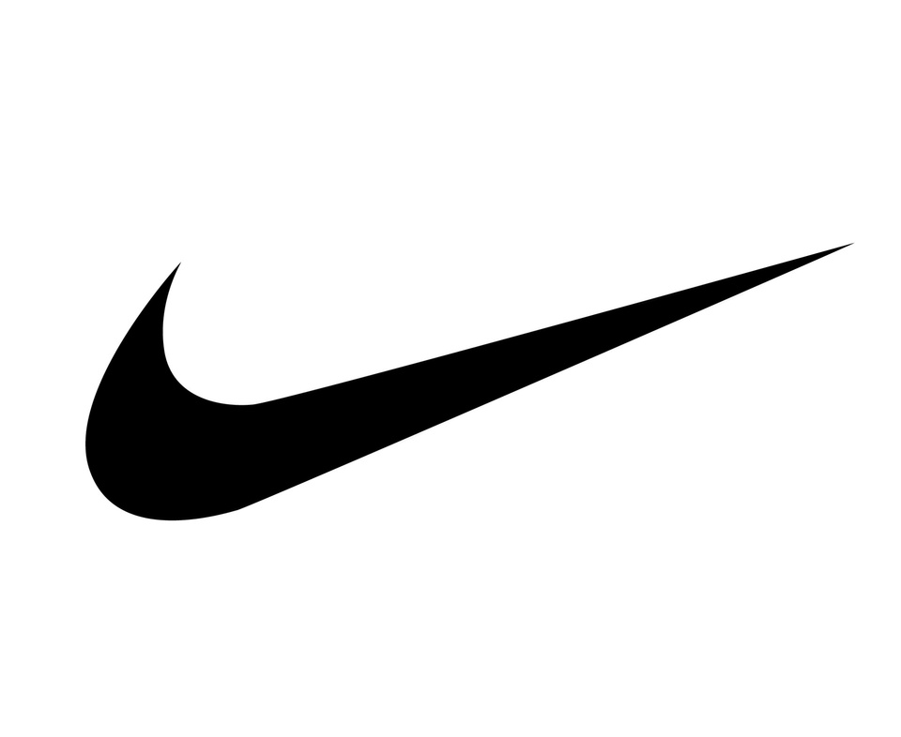
NIKE POSITIONING STRATEGY: SHAPING THE FUTURE OF AN ICON
GROUP - 1

Slide 2




Today’s Presenters
Jackson Rose
Harsha Mishra
Parv Khandelwal
Venkat

Slide 3
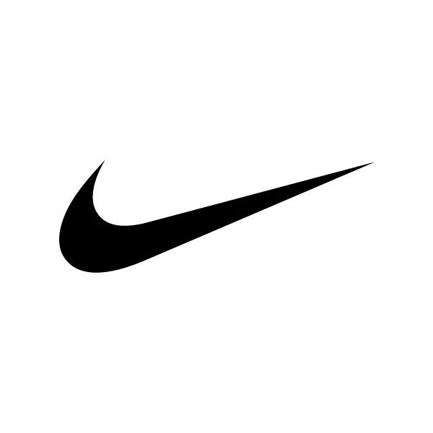
AGENDA
01
05
Executive Summary
Data Collection Approach
02
06
Market Position
Strategic Recommendations
03
07
Current Situation Analysis
Key Takeaways
04
08
Conclusion
Competitor Overview

Slide 4
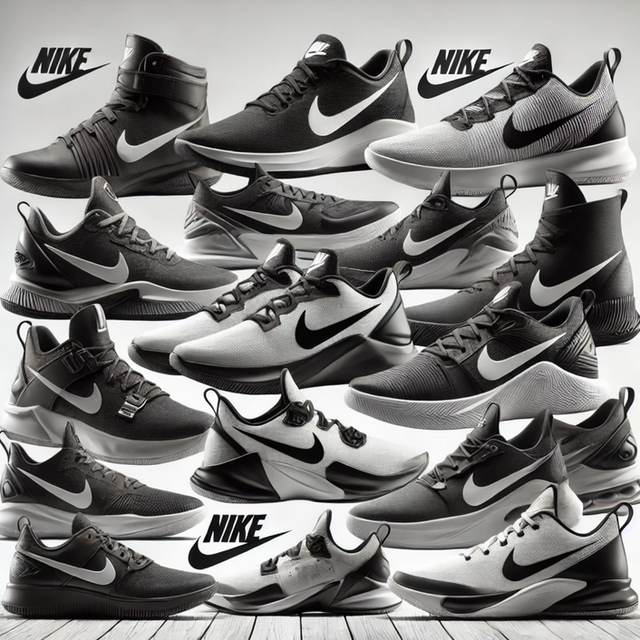
EXECUTIVE SUMMARY
Nike is a globally recognized brand known for its athletic, community-focused, and comfort-driven footwear and apparel. However, despite its strong reputation, there is always room for growth. Every day, Nike faces fierce competition in the footwear and apparel industry.
Our goal is to analyze market segmentation data to identify Nike’s strengths, helping the company make informed decisions on where to invest and expand its market presence.

Slide 5
NIKE’S POSITION IN THE MARKET AND COMPETITIVE LANDSCAPE
Global Footwear Dominance: Nike reported $33.13 billion in footwear revenue for the fiscal year ending May 2024, contributing over 64% of its total $51.36 billion global revenue.
Leading Market Share: Nike holds a 38.2% share of the global athletic footwear market, solidifying its position as the top sneaker brand worldwide.
Running Shoe Leadership with Rising Competition: While Nike remains a key player in the running shoe market, its combined market share (with Adidas) has dropped from 70% to just over 50% due to rising competition from brands like On and Hoka.

Slide 6

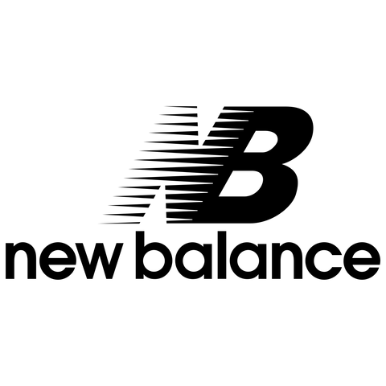

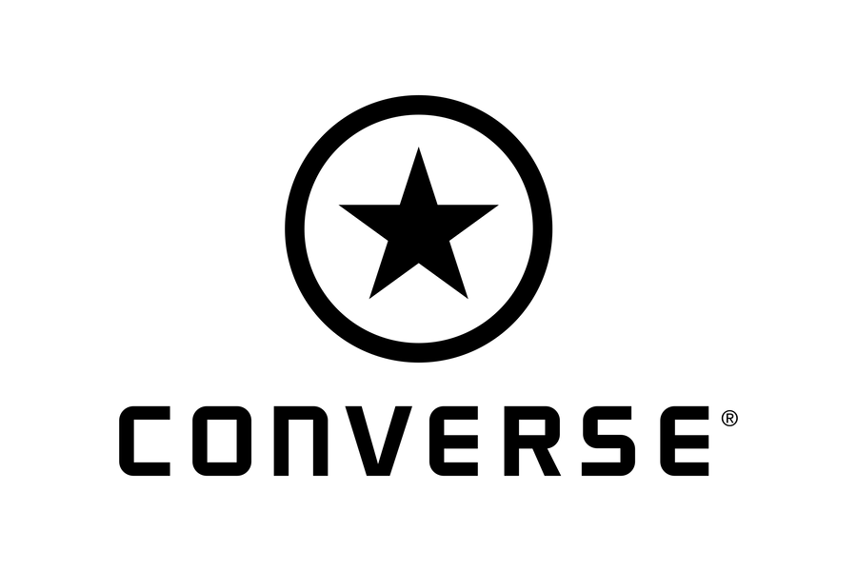
KEY PLAYERS AND THEIR MARKET POSITIONING
Adidas reported an estimated global revenue of $22.5 billion in 2024, with a 7% market share in the U.S. athletic footwear sector. Its growth has been driven by the popularity of models like the Samba and Gazelle, though there are concerns about the sustainability of this trend
New Balance achieved $7.8 billion in revenue in 2024, a 20% increase from the previous year. It holds a 7.4% share in the running shoe market and continues to grow in popularity
In fiscal year 2024, Vans saw a 24% decline in global revenue, with a 26% drop in the fourth quarter, bringing revenue down to $631.2 million. The brand continues to lose market share due to growing competition and changing consumer preferences.
For the fiscal year ending May 31, 2024, Converse reported $2.1 billion in revenue, a 14% decrease from the previous year. In the second quarter of fiscal 2025, revenue fell 17% to $429 million. Despite being one of the top five sneaker brands in the U.S., Converse’s market share continues to decline.

Slide 7
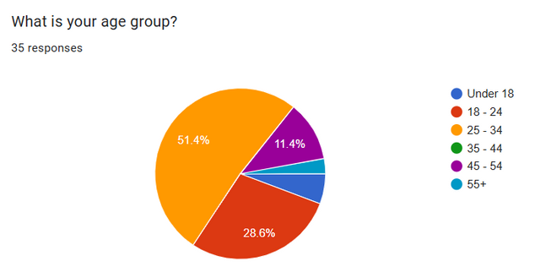
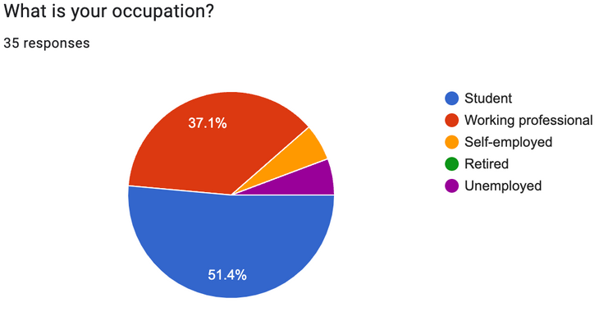
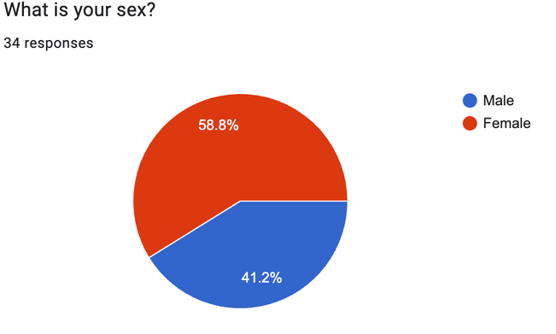
GATHERING PERCEPTUAL AND PREFERENCE DATA
We conducted a customer survey across a diverse demographic to capture perceptual and preference data. The survey focused on brand perception, product quality, pricing, style preferences, and brand loyalty.
Perceptual data :
we asked participants to rate their overall impression of Nike, Adidas, New Balance, Vans, and Converse, evaluating aspects like brand image, innovation, and design.
Preference Data:
we gathered insights on purchasing behavior, brand preference for sports and lifestyle shoes, perceived value, and factors influencing buying decisions.

Slide 8
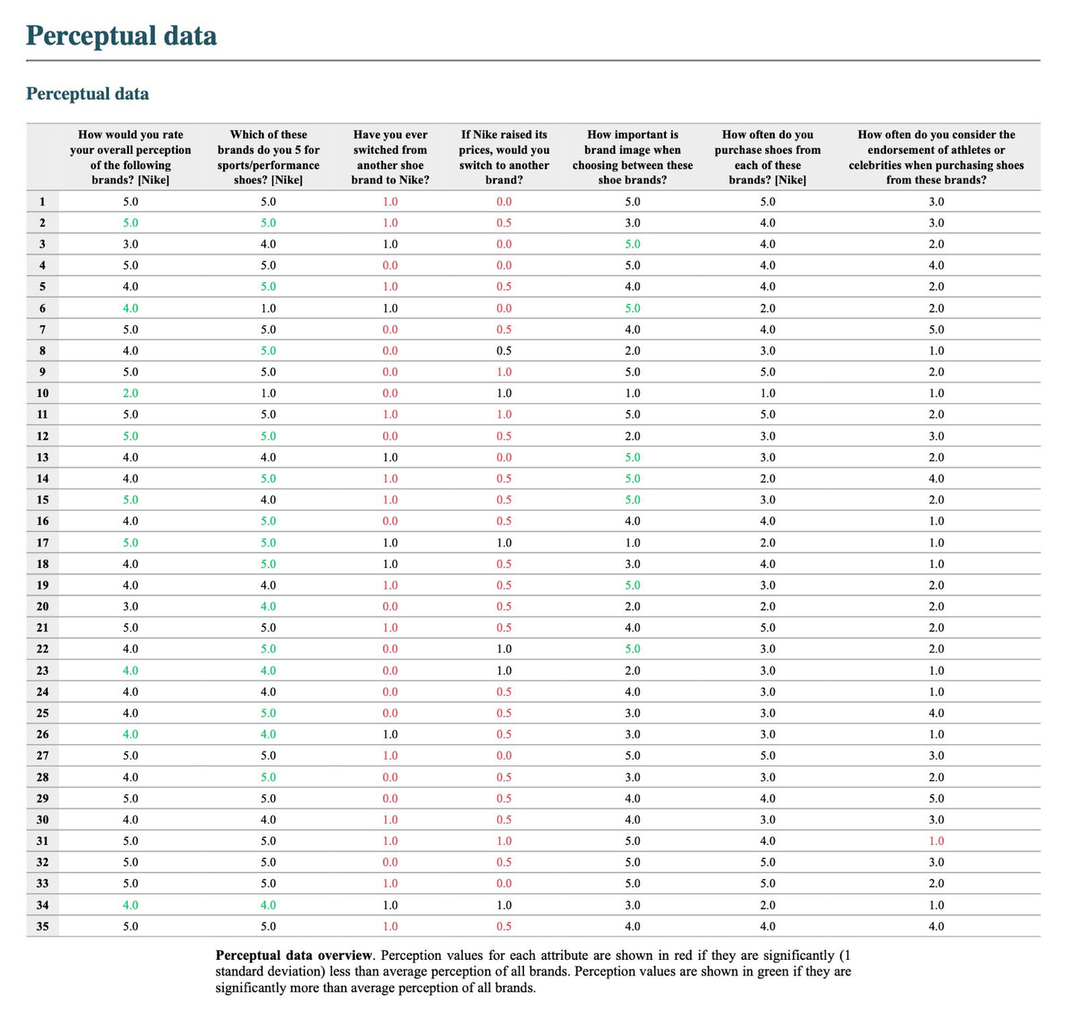

Slide 9
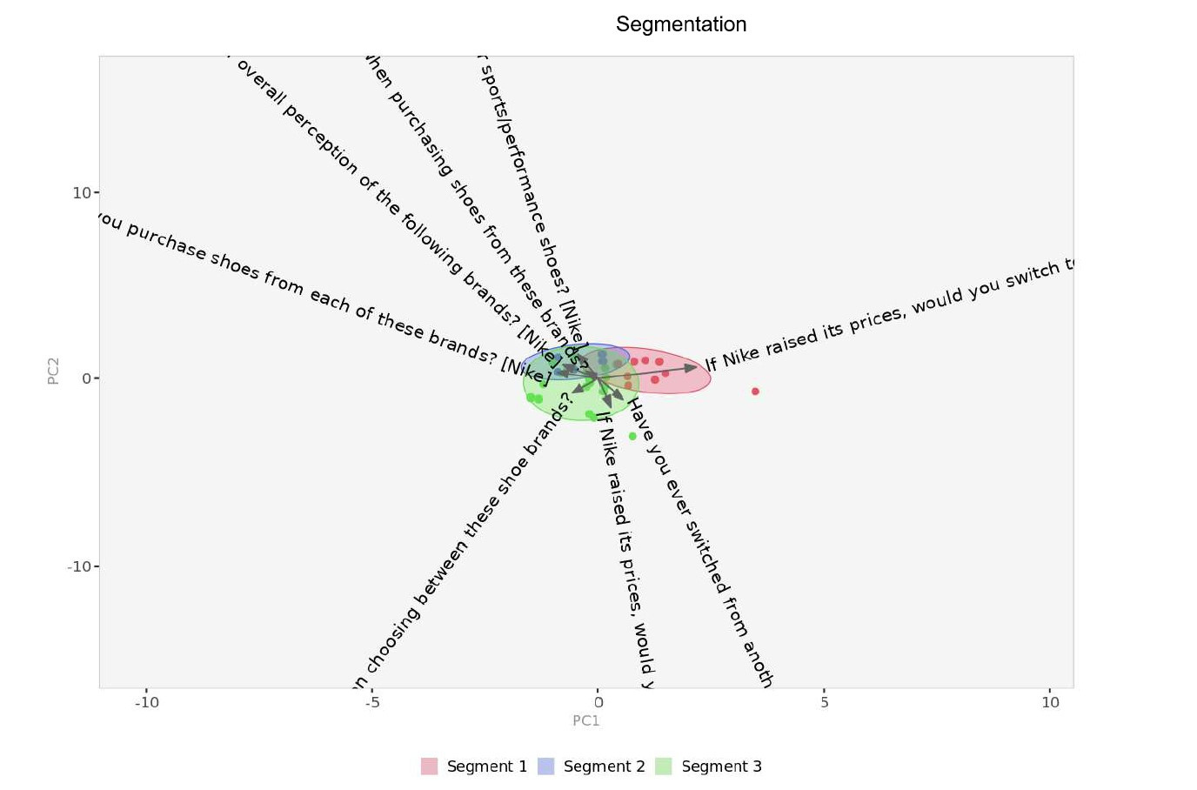
SEGMENTATION

Slide 10
METHODOLOGY
We conducted a customer survey with 35 respondents from diverse demographics to capture perceptual and preference data on five major sneaker brands: Nike, Adidas, New Balance, Vans, and Converse. The survey included both rating scales and multiple-choice questions, focusing on:
Brand Perception
Product Quality & Performance
Innovation & Design
Overall impression, brand association for sports and casual wear, and likelihood to recommend.
Ratings on shoe quality, durability, comfort, and trust in athletic performance.
Perception of innovation, technology, and design appeal.
Pricing & Value
Style & Trends:
Loyalty & Behavior
Price-to-value ratio, affordability, and perceptions of deals and discounts.
Trend-setting in sneaker fashion and design preferences.
Purchase frequency, willingness to switch brands, and impact of brand image and endorsements.

Slide 11
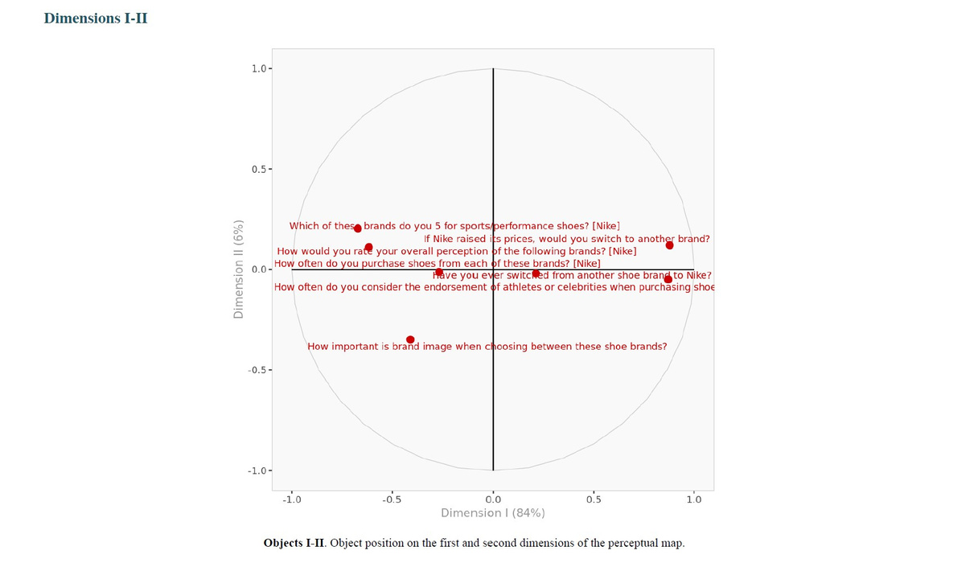
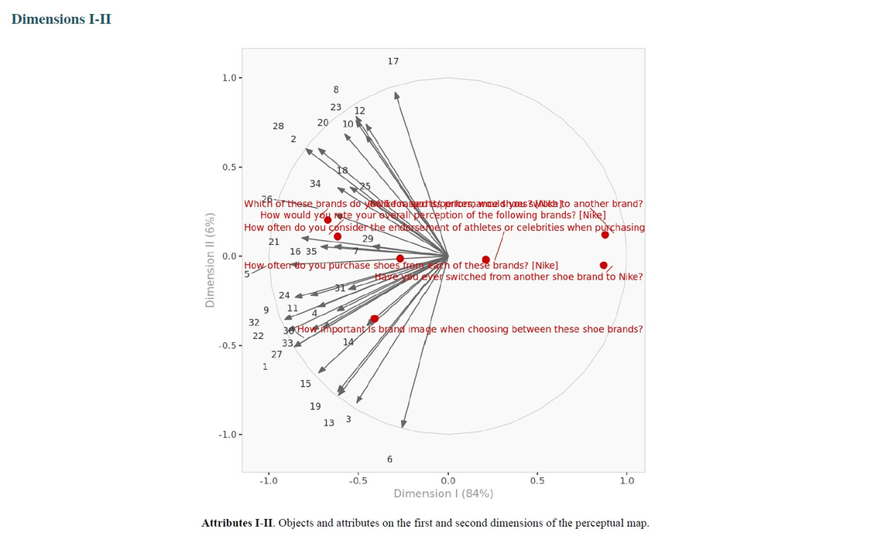
POSITIONING ANALYSIS

Slide 12
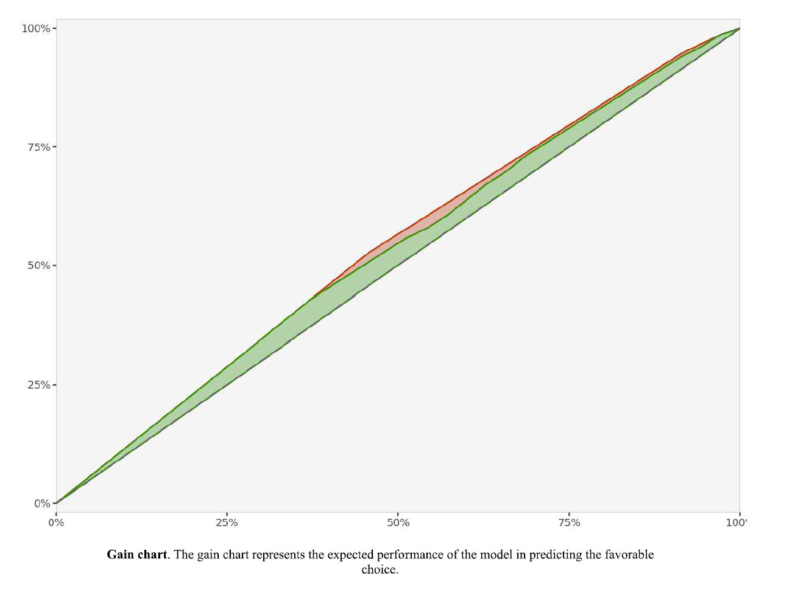
PREDICTIVE MODELLING
GAIN CHART

Slide 13
INSIGHTS FROM THE DATA
This analysis helped identify Nike’s competitive position and opportunities to strengthen its market standing through innovation, product quality, and targeted marketing efforts.
Nike’s Strength
Adidas’ Popularity
New Balance’s Growth
Nike emerged as a leader in athletic performance and innovation, with high ratings for quality and brand image. It was most trusted for sports shoes and had strong recommendations.
Adidas showed strong brand perception and was widely recognized for trend-setting and appealing shoe designs, particularly for lifestyle wear.
New Balance scored well in comfort and durability, indicating strong product quality despite lower perception in innovation and style.
Vans’ Niche Appeal
Converse’s Decline
Vans was strongly associated with casual and lifestyle wear but lagged in athletic performance and perceived innovation.
While Converse remains a familiar brand, it showed declining market share and lower ratings in comfort, innovation, and value.

Slide 14
WHAT THE MAPS REVEAL ABOUT NIKE AND ITS COMPETITORS
According to the survey done, Nike stands above all of its competitors that were listed. Customers viewed Nike more positively, compare to its competitors with the following being key factors:
Sports and Performance
Best Deals and Discounts
Consistent Purchasing
Nike’s brand is based on its athletic performance apparel. Compared to its competitors Nike was the most prefered.
Consumers believed that Nike offered the best deals and discounts, demonstrating its affordability to the consumers.
Consumers consistently shopped at Nike the mostcompared to the competitors correlating the value the consumers have with its brand.

Slide 15
STRATEGIES TO STRENGTHEN NIKE’S MARKET POSITION
Pricing
Expand Endorsement Impact
The greatest desensitize to change to a different brand is whether or not Nike would change the pricing on its products. Nike should focus its efforts on maintaining is pricing without sacrificing quality.
Although 28.6% of respondents frequently consider athlete or celebrity endorsements, Nike can strengthen its market position by deepening collaborations with influential figures and emphasizing their association with performance and style.
Leveraging Athletic Performance Strength
Strengthen Brand Loyalty
Nike is highly trusted for athletic performance shoes (40%) but faces competition from New Balance (34.3%). Nike can build on this by promoting product innovation and performance-driven technology more aggressively.
While 60% of respondents would choose Nike for style alone, 57.1% indicated they might switch brands if Nike raised prices. Nike should focus on loyalty programs and value-driven marketing to retain its customer base.
Enhance Design and Style Appeal
Survey data shows that Adidas (65.7%) and Vans (62.9%) lead in setting sneaker fashion trends. Nike should focus on more innovative and appealing designs to strengthen its position in lifestyle and casual wear.

Slide 16
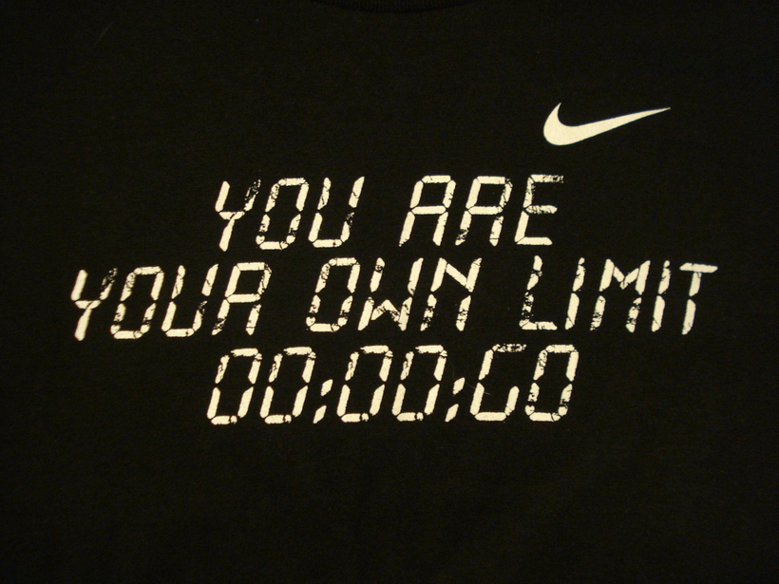
LIMITATIONS
Constraints and Considerations
Small survey sample may introduce bias and limit market representation.
Changing consumer preferences require ongoing market research and updates.
Overlapping segments make precise targeting and differentiation challenging.
Complex targeting strategies arise due to segmentation overlaps and market variations.
Continuous refinement is necessary to keep segmentation and positioning effective.

Slide 17
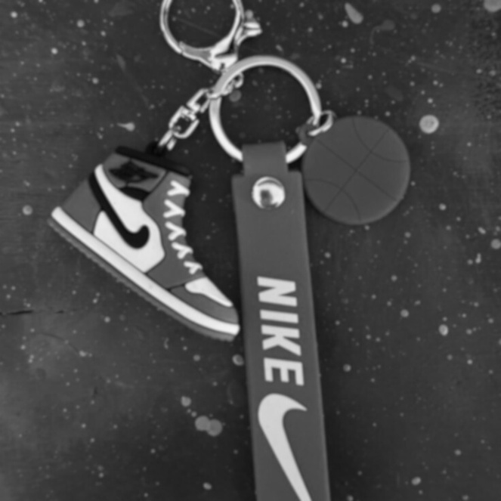
Key Takeaways
Summarizing the Insights and Next Steps
Market segmentation enhances brand positioning by effectively targeting the right customers.
Perceptual mapping refines brand identity and strengthens competitive differentiation.
Consumer insights and predictive modeling help businesses stay ahead of market trends.
Nike’s strong brand loyalty requires strategic pricing and messaging to address price sensitivity.
Continuous market assessment is essential for adapting to evolving consumer behaviors.

Slide 18
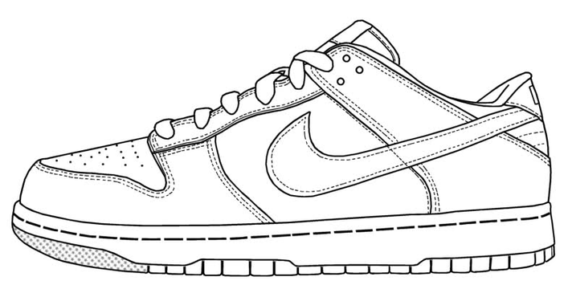
CONCLUSION
Nike’s Path to Continued Market Leadership
This research highlights the significance of market segmentation and positioning in building a strong competitive strategy. Utilizing demographic, psychographic, and behavioral segmentation enables businesses to reach diverse consumer groups more effectively. Perceptual mapping helps refine brand identity and distinguish it from competitors, particularly in the sports footwear market. While Nike maintains strong brand loyalty, addressing price sensitivity through strategic pricing and messaging is crucial. Despite challenges like sample bias and shifting consumer preferences, ongoing market research and predictive modeling are vital for sustaining a competitive edge and adapting to industry trends.

Slide 19
Q & A: OPEN FLOOR FOR DISCUSSION

